Slide 1
Food Service

Slide 2
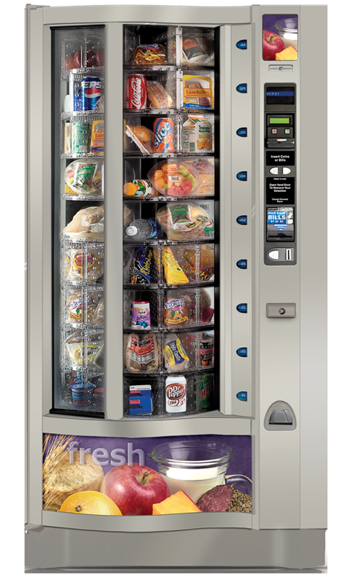
General Information
General information/update:
Wilsonville
Harmony
Oregon City
Update on Jewel Hospitality
Community Input/Surveys
Next Steps

Slide 3
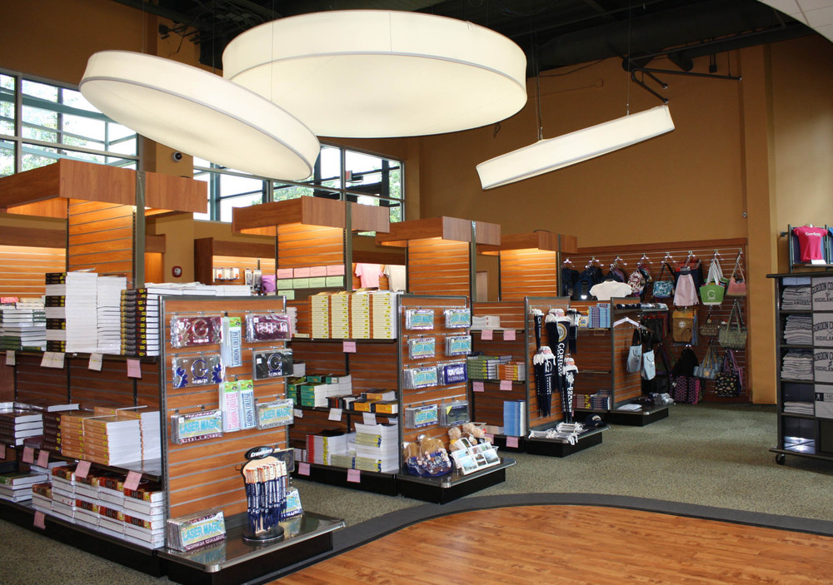
Bookstore
General Information
Barnes & Noble
Russell Markman from Collegiate
Retail Consultants

Slide 4
Community Input
Taskforce Members
Taskforce membership
Student EYES Survey
Faculty & Admin Assistant Survey
Makayla Blackburn
Stephen Brouwers
Wesley Buchholz
Virginia Chambers
John Ginsburg
Benjamin Melles (Student Representative)
Loretta Mills
Justine Munds (Chair)
Adrienne Phillips
Lisa Reynolds
Jeff Shaffer

Slide 5
RFP Timeline
RFP Developed and finalized 3/1/23
RFP issued. Weekly CCC team + Russell calls 3/13/23
Pre-proposal meeting 3/27/23
Vendor Written questions due 4/3/23
College answers vendor questions 4/7/23
Vendor proposals due – review process begins 4/17/23
Presentations from Vendors 5/1/23
College Committee Debrief 5/5/23
Successful Vendor Selected (Verbal Award) 5/12/23
Contract draft created by CRCG 5/15/23
Vendor and College launch call #1 5/19/23
Contract Negotiations 5/26/23
Vendor and College IT call 5/29/23
Vendor and College Financial Aid call 6/2/23
Vendor and College launch call #2 6/2/23
Vendor Contract Finalized 6/5/23
Transition begins 6/5/23
Bookstore Opens 8/7/23

Slide 6
Goals
Affordability
Collaboration
Ease of transition

